Slide 1
Actors DIAGRAM:
Person who wants to visit an employee in these offices. (VISITOR-a head count who wants to visit the office. Can be anyone who is a non-employee of that office.)
Person whom the visitor wants to meet. (EMPLOYEE)
Person who approves the confirmation of meeting request. (HIGHER-OFFICIAL)
Person who does physical checking/ manual checking /frisking of the visitor on premises. (SECURITY GUARD)
Person at Reception desk. (RECEPTIONIST)
Holograms Security Personnel.

Slide 2
Security Clearance Levels:
LEVEL-01: When the request for a meeting is made, an authenticated person can only make the request.
LEVEL-02: MANUAL FRISKING by the security guard and ID cards and SMS shown to him.
LEVEL-03: RECEPTION DESK: FRS and BIOMETRICS of the visitor for the m-pass generation.
LEVEL-04: HOLOGRAMS guide the visitor to the employee’s room. HOLOGRAMS are under direct control of security personnel.
LEVEL-05: QR code scanner : you have met the right person.
LEVEL-06: EXIT: path you are under surveillance through holograms and cameras.
LEVEL-07: Voice trigger exit at reception.

Slide 3

Parity website hosted on a global server
VISITOR
LOGO
PARITY INFOTECH SOLUTIONS PRIVATE LIMITED
1. Visit the office
2. Employee Login
CONTENT
Button
Welcome to Parity InfoTech Solutions Private Limited…

Slide 4
Person clicks on the button 1: Visit the Office
VISITOR
LOGO
PARITY INFOTECH SOLUTIONS PRIVATE LIMITED
VISITOR’S MEETING REGISTRATION FORM
1.a LANGUAGE
Button
Kindly choose your language…..

Slide 5
Person clicks on the button 1.a: Language
. Dropdown opens up with a list of languages including vernacular
VISITOR
LOGO
PARITY INFOTECH SOLUTIONS PRIVATE LIMITED
VISITOR’S MEETING REGISTRATION FORM
1.a LANGUAGE
English
Hindi
Punjabi
Gujarati
Malayalam
Kannada
……..
……..
The person clicks on his required language option. The form options will appear in that language choice.

Slide 6


EXAMPLE: Person clicks on the English option
VISITOR
LOGO
PARITY INFOTECH SOLUTIONS PRIVATE LIMITED
VISITOR’S MEETING REGISTRATION FORM
ENGLISH
Name:
Date of Birth:
Take Snapshot:
AADHAR Number:
RESULT
Announces….
TEXT INPUT
YES
The person is authentic.
TEXT INPUT
PHOTO PREVIEW
CLICK NEXT…..
1.c NEXT
TEXT INPUT
The credentials do not match.
NO
1.b AUTHENTICATE
When the person clicks on the AUTHENTICATE button, it connects to the UIDAI database and identifies the person as authentic or not…………………………

Slide 7


When the RESULT passes, the authenticated person clicks on 1.c NEXT for further details on booking
a meeting.
VISITOR
If the RESULT is not matched, the person is returned back to the original form.
LOGO
PARITY INFOTECH SOLUTIONS PRIVATE LIMITED
VISITOR’S MEETING REGISTRATION FORM
ENGLISH
Organization:
Designation:
To Meet: Purpose:
DATE SLOTS: Time Slot:
PHONE NUMBER:
RESULT
TEXT INPUT
YES
The person is authentic.
TEXT INPUT
TEXT
TEXT
CLICK NEXT…..
1.c NEXT
TEXT
TEXT
NO
The credentials do not match.
Voice Input
1.d Send OTP
Fields in Black are text input. Field in Red is VOICE INPUT and OTP VERIFICATION.

Slide 8
Insert the text field inputs. Insert the voice input… keep a button to trigger it. And save it.
Show it in the input box and then if accurate record it. If not recorded correctly, simply re-record it.
VISITOR
LOGO
PARITY INFOTECH SOLUTIONS PRIVATE LIMITED
VISITOR’S MEETING REGISTRATION FORM
ENGLISH
Organization:
Designation:
To Meet: Purpose:
DATE SLOTS: TIME SLOTS:
PHONE NUMBER:
TEXT INPUT
An OTP is sent to the given mobile number.
TEXT INPUT
OTP:
ENTER OTP
TEXT
TEXT
OTP matches
OTP not matches
TEXT
TEXT
Phone number verified successfully. Added to the UIDAI db.
Kindly try again..
Use your AADHAR verified phone number
VOICE INPUT
Say the digits individually
1.D Send OTP
After phone number is OTP-verified….

Slide 9
VISITOR
The person clicks on 1.e Register for meeting button to forward the request to the concerned officer.
LOGO
PARITY INFOTECH SOLUTIONS PRIVATE LIMITED
VISITOR’S MEETING REGISTRATION FORM
ENGLISH
1.e Register request
“Your request has been saved successfully”.
An SMS is sent to the person regarding his meeting request.
An SMS alert is also sent to the to_meet person regarding a meeting request generated on your name and a notification on his EMPLOYEE portal meeting request shows up.
1.f Back to the Website page.
The request is forwarded and saved to the db along with the UIDAI verification security clearance obtained………….

Slide 10
Parity website hosted on a global server
EMPLOYEE
LOGO
PARITY INFOTECH SOLUTIONS PRIVATE LIMITED
1. Visit the office
2. Employee Login
CONTENT
Button

Slide 11

Person clicks on the button 2: Employee Login Portal
EMPLOYEE
LOGO
PARITY INFOTECH SOLUTIONS PRIVATE LIMITED
EMPLOYEE LOGIN
Voice matches.
USERNAME
PASSWORD
VOICE LOGIN
Voice does not match.
USERNAME
EMPLOYEE LOGIN is successful.
AN SMS is sent to the employee on his phone. This device has tried to access your Login
EMPLOYEE LOGIN is unsuccessful.
AN SMS is sent to the employee on his phone. This device has tried to access your Login
PASSWORD
“123456”
Employee has to say the word or combination of numbers and it goes via speaker login authentication

Slide 12

If Employee login is successful, he is redirected to the employee specific dashboard
EMPLOYEE
LOGO
PARITY INFOTECH SOLUTIONS PRIVATE LIMITED
EMPLOYEE LOGIN
Hi! ABC
SIDEBAR
…………….
Meeting Requests
………………
Meetings Confirmed
………………
Meetings Approved
DASHBOARD
Sidebar Navigation Options
Employee clicks on Meeting Requests tab.

Slide 13

Employee sees the request on his dashboard.
EMPLOYEE
LOGO
PARITY INFOTECH SOLUTIONS PRIVATE LIMITED
EMPLOYEE LOGIN
Hi! ABC
SIDEBAR
…………….
Meeting Requests
………………
Meetings Requests
Consented
………………
Meetings Approved
Dashboard/Meeting Requests-
Date | Name | Designation | Purpose | Organization | Date/Time | Consent
05-09-2020 | Visitor | Secretary | Official | MHA | 07-Sept 4-6 PM | Pending
If the employee clicks on Red button, the meeting is cancelled. An SMS is sent to the visitor, that the person is not
available at that time. Kindly try another time. If the employee clicks on Green button. The meeting request is forwarded
to the higher official for approval

Slide 14
If the higher official clicks on Red button, the meeting is cancelled. An SMS is sent to the visitor, that the person is not available at that time. Also, in approved meetings of the employee, it shows ‘cancelled’. If the higher official clicks on
Green button. The meeting request is forwarded to the higher official for approval or forwarded to the Security personnel informing them about the visit and add it to the reception desk-the record of the visitor.
HIGHER OFFICIAL
LOGO
PARITY INFOTECH SOLUTIONS PRIVATE LIMITED
EMPLOYEE LOGIN of HIGHER AUTHORITY OFFICIAL
Hi! GHI
SIDEBAR
…………….
Meeting Requests
………………
Meetings
Requests
Consented
………………
Meetings Approved
Date | Name | Designation | Purpose | Organization | Date/Time | To Meet | Approve
05-09-2020 | Visitor | Secretary | Official | MHA | 07-Sept 4-6 PM | ABC | Approval

Slide 15
There happens manual checking/frisking of the visitor by the security guard at the gate. His photo is matched to that uploaded by the visitor in his form for meeting request.
The Security Guard fills his report for security clearance of the visitor.
SECURITY GUARD
LOGO
PARITY INFOTECH SOLUTIONS PRIVATE LIMITED
SECURITY OFFICER at BUILDING-GATE
Hi! SEC
Today’s VISITORS
Meeting Requests
………………
Meetings
Requests
Consented
………………
Meetings Approved
Today’s VISITORS:
Visitor photo | Name | Designation | Organization | Date/Time | SMS | ID card | Security Clearance REPORT
 | Visitor | Secretary | MHA | 07-Sept 2020 4-6 PM | SHOWN | SHOWN | CLEAR
An SMS is sent to the employee that his visitor has arrived. So, he is ready at his office room.

Slide 16




The receptionist welcomes the visitor. “Hello Sir/Ma’am. How may I help you? First you have to undergo a security check by standing in front of the camera.” Welcome, Mr. Visitor. Kindly give me your thumbprint. Thankyou, Mr. $(Visitor’s name) or Ms. $(Visitor’s name). Your credentials have been matched successfully”
LOGO
PARITY INFOTECH SOLUTIONS PRIVATE LIMITED
RECEPTION DESK
Hi! REC
Today’s VISITORS
Meeting Requests
………………
Meetings
Requests
Consented
………………
Meetings Approved
Today’s VISITORS:
Visitor photo | Name | Designation | Org | Date/Time | Security Clearance At GATE | AADHAR Card Submit | FRS | M-pass/hard copy printed
 | Visitor | Secretary | MHA | 07-Sept 2020 4-6 PM | Clear | Yes | Score Diff: _____ _____ _____ | Generated- Use Biometric
RECEPTIONIST

Slide 17

We need an FRS that tells you
how the face is different from
the earlier photo and not
matching up to a perfect 1.0 score……
Tell me the reason why
it is not 1.0 match….

Slide 18
Visitor photo | Name | Designation | Org | Date/Time | Security Clearance At GATE | AADHAR/ID-Card Submit | FRS Report | Print initialized | M-pass/hard copy printed
 | Visitor | Secretary | MHA | 07-Sept 2020 4-6 PM | Clear | Yes | Score Diff: ______ >85% _____ |  | Generated- Use Biometric
Weighted averages: Neural Networks
We weigh out the results of different tests:
1) FRS match-20%
2) Biometrics-30%
3) Manual check at Gate-50%
If anywhere it fails, there is a provision to take next action based on the organization.
In the beginning when the system is being trained intelligently,
On Clicking the Red Button , print of m-pass is not made. Hence, the person is sent back for questioning by the Security Personnel. On clicking the Green Button , an agreement is reached on computerized and manual security and the person is allowed to receive the m-pass. Thank you, $(Mr. Visitor) for your cooperation.

Slide 19

HOLOGRAMS/VIRTUAL REALITY

Slide 20

HOLOLENS in Hospitals

Slide 21
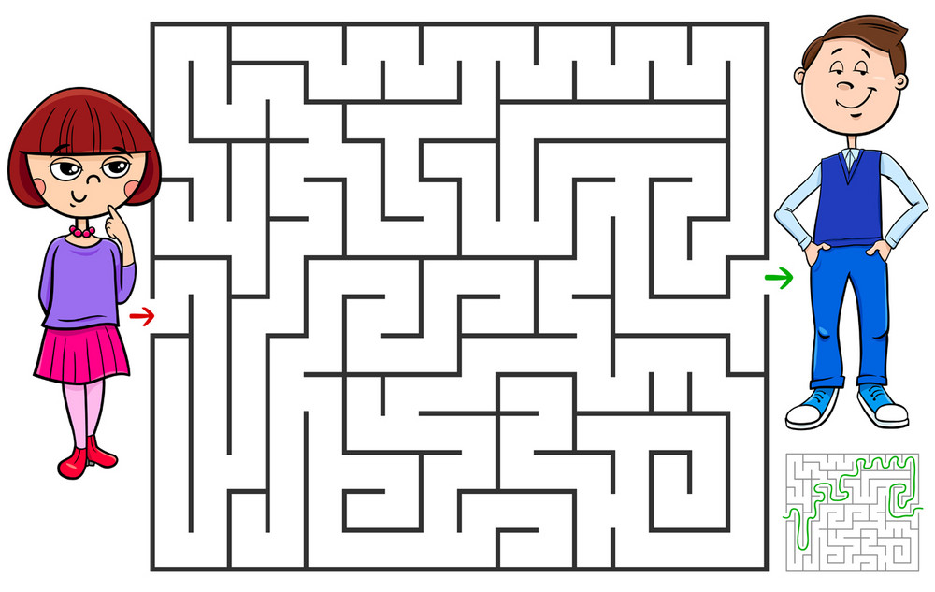
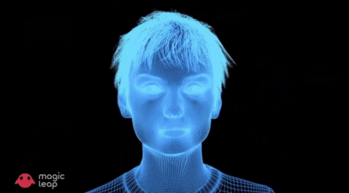
VIRTUAL HUMANOID SECURITY ESCORT
It’s a security personnel hologram that escorts a visitor to the destination after noting the destination in from m-pass initiated by the receptionist. So, the number of
Hologram images can be controlled by the
Reception desk.
The escort takes the visitor to the destined room after seeing the name on the m-pass. This can be made to read from the computerized input of the destined room or reading it from the paper using OCR tesseract library in python.
The person reaches the destined venue under the guidance of VHSE.

Slide 22
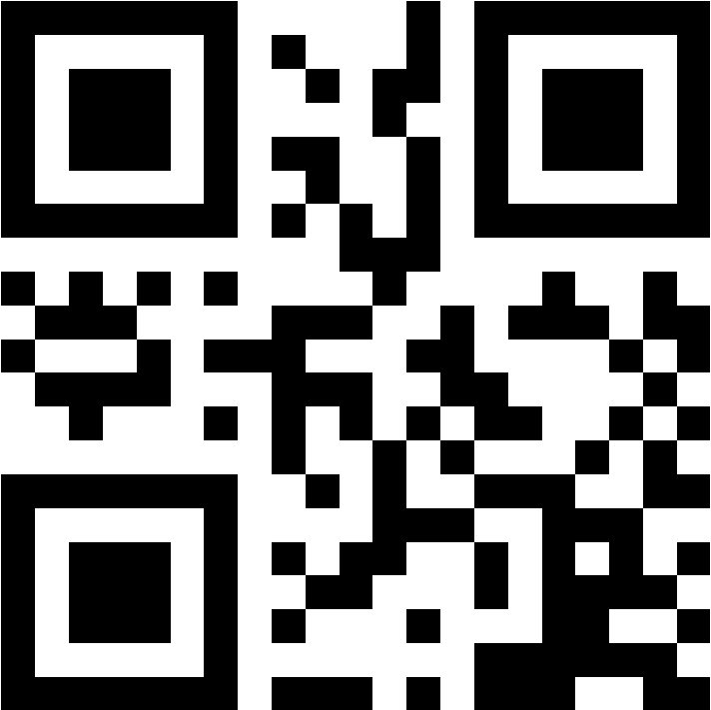
Visitor Lounge/EMPLOYEE TABLE:
QR SCANNER
The QR Scanner reads the QR code given on M-pass of the visitor. Ensures the timing of the TTL (Time to Live) of the QR code scanner is ensured.
QR code confirms that the right person has met the right person.
Welcome Mr. $(Visitor Name)…… by the machine.
The meeting can begin…………………………
MEETING BEGINS…

Slide 23
Meeting Happens
Meeting is near the end time
Meeting ends on time
Meeting extends beyond the stipulated time
EMPLOYEE’s OFFICE

Slide 24
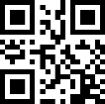
The employee accesses the visitor panel using his ID card’s bar-code and logins into the panel where the following dashboard appears
EMPLOYEE
LOGO
PARITY INFOTECH SOLUTIONS PRIVATE LIMITED
VISITOR PANEL
Today’s Visitors:
Date/Time | Employee Name | Visitor M-pass | QR code Scanner | EXIT
06-09-2020 4 to 6 pm | ABC | M-01 | Done accurately | Permit
Clicking on Red button, implies that the meeting has been extended. Will not end so soon.
Clicking on Green button, implies that the meeting has ended.
So, employee clicks on green button when the meeting ends which signals the virtual escort to come and take the visitor back to reception.

Slide 25
VIRTUAL HUMANOID SECURITY ESCORT
It’s a security personnel hologram that escorts a visitor to the destination after noting the destination in from m-pass initiated by the receptionist. So, the number of
Hologram images can be controlled by the
Reception desk.
The escort takes the visitor to the destined room after seeing the name on the m-pass. This can be made to read from the computerized input of the destined room or reading it from the paper using OCR tesseract library in python.
The person reaches the reception under the guidance of VHSE.

Slide 26
The visitor says ‘EXIT’ in front of the screen, collects his AADHAR card and his exit is marked. Voice input is being used. The phone number which was recorded as a sample and saved in the database to mark his exit time.
LOGO
PARITY INFOTECH SOLUTIONS PRIVATE LIMITED
RECEPTION DESK
Hi! REC
Today’s VISITORS:
Visitor photo | Name | Designation | Org | Date/Time | Security Clearance At GATE | AADHAR Card Submit | FRS | M-pass/hard copy printed | EXIT Time
 | Visitor | Secretary | MHA | 07-Sept 2020 4-6 PM | Clear | Yes | Score Diff: | Generated
RECEPTION DESK

Slide 27
The VISITOR exits through the main gate
……………
………….
XXXXXX
……………….

